Slide 1
Exercise 4 Continuous time-independent SchrODINGER equation
QUANTUM INFORMATION AND COMPUTING course 2021/2022
Alessandro marcomini (2024286)
Prof. Simone montangero

Slide 2

Exercise goals
Consider the one-dimensional quantum harmonic oscillator defined by the Hamiltonian
$$H={\hat{p}}^{2}+ ω^{2}{\hat{x}}^{2}$$
Write a Fortran program to compute the first $k$ eigenvalues $E_{k}$ and eigenvectors |${\text{ψ}}_{k}$⟩.
Rate your program in terms of the priorities for good scientific software development (Correctness, Stability, Accurate discretization, Flexibility, Efficiency)

Slide 3

WHAT SHOULD I EXPECT?
Theory of quantum mechanics: eigenvalues in the form $E_{n}=2×\left(n+1/2\right)ℏω$ $⇒$ constant difference among eigenvals
Eigenfunctions: Hermite functions (# of nodes = $n$)
Finite size: discretize second derivative operator in ${\hat{p}}^{2}$ as
${ψ_{n}}^{′′}= \frac{ψ_{n−1}−2ψ_{n}+ψ_{n+1}}{{∆x}^{2}}+θ({∆x}^{4})$
At the boundaries, expected no kinetic contribution: for $x∈[−L,L]$
$$ω^{2}L^{2}=E_{n} ⇒L={\sqrt{E_{n}}}/ω$$

Slide 4
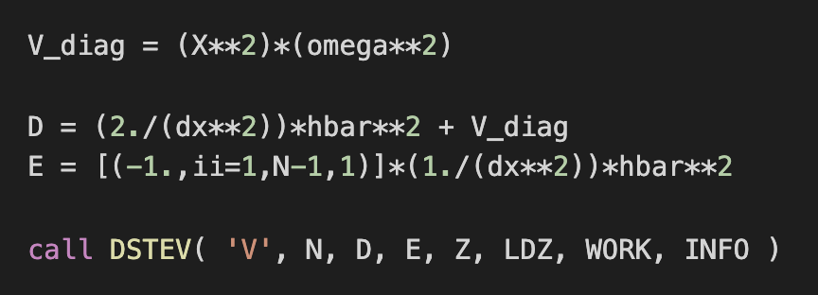
Code developement
Use of LAPACK’s DSTEV for hamiltonian diagonalization
Avoid defining zero elements to improve efficiency and reduce memory use
Add pre-conditions on input variables (e.g, non-negative discretization interval and number of points
Add post-condition on exit status of DSTEV

Slide 5
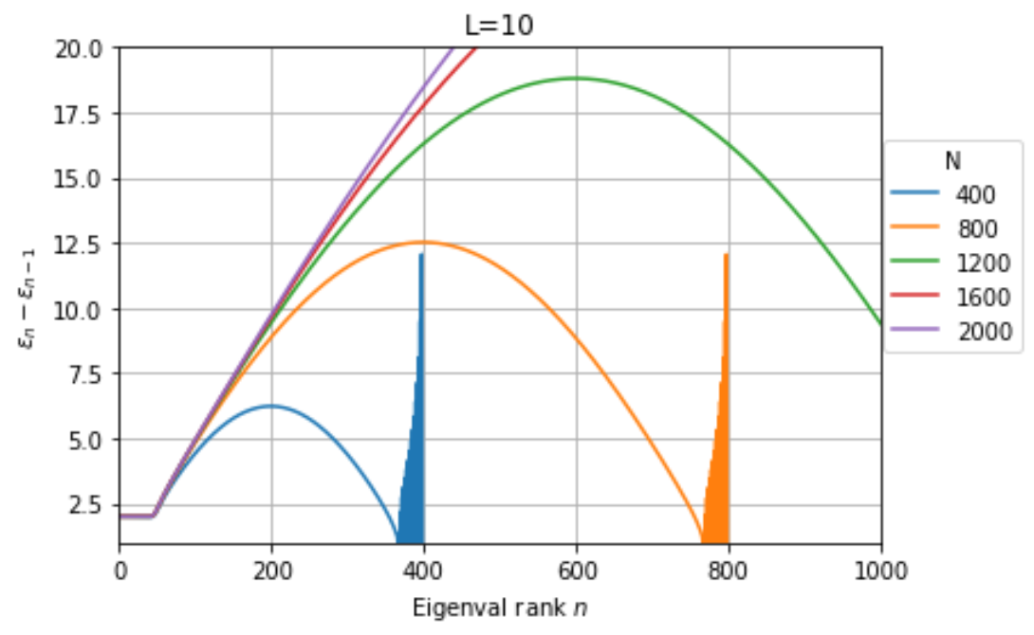
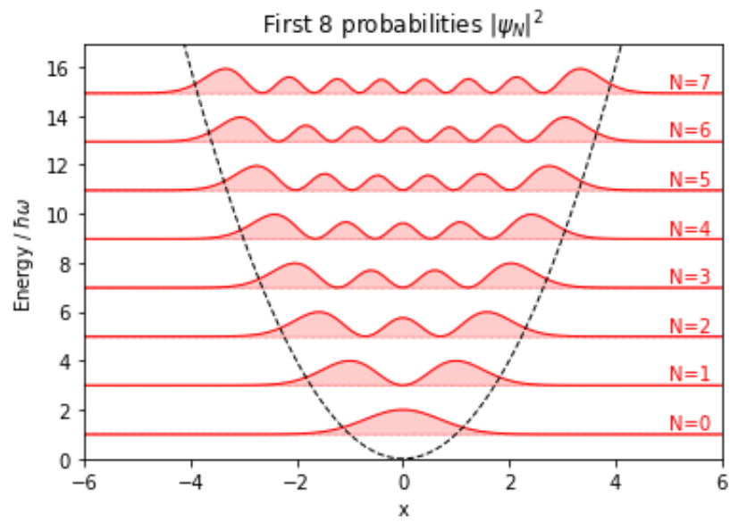
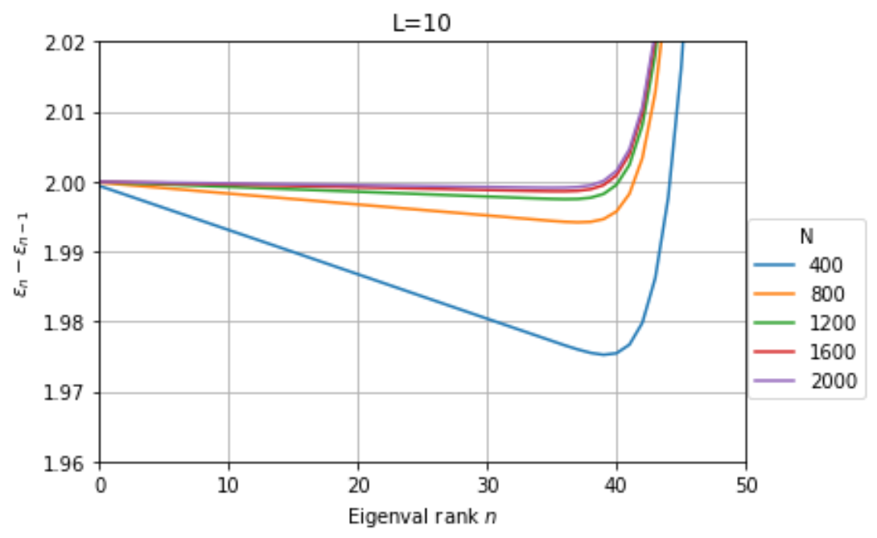
RESULTS – PDFs and dependence on N

Slide 6
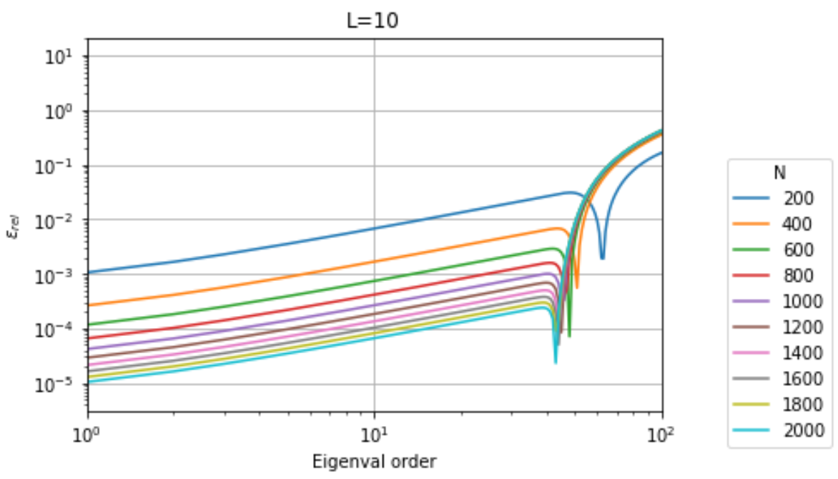
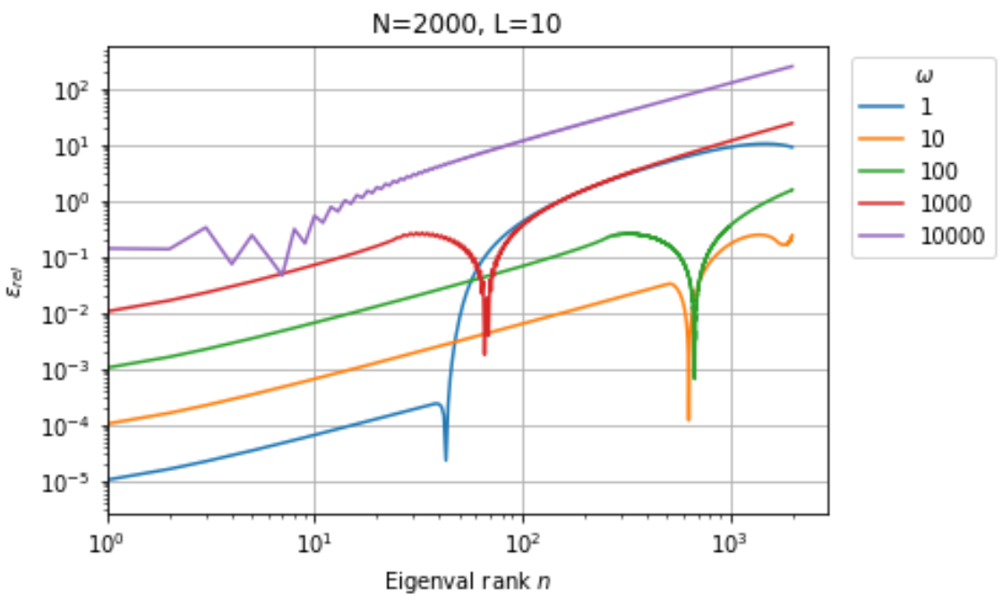


RESULTS – dependence on L and $ω$
Final OVERVIEW
It is hard to keep under control the whole algorithm: by one side, a larger L allows to estimate better higher level eigenvalues, the quality on the first ones. Similarly, a larger N allows for better precision on first energy levels, by it must be set wrt L. Changing $ω$ means scaling the eigenvals: the last plot suggest that it must also be taken into consideration while setting the best N, L.

